Slide 1
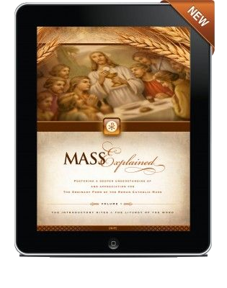
Catholic Digital Evangelization
A Ministry to Meet People Where They Are- ONLINE

Slide 2
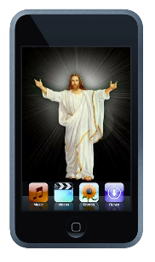
Mission and Goals
Our mission is to Evangelize and re-energize the church by meeting people where they are- ONLINE.
Our goal is to utilize social media, our website, digital kiosk, video presentations, digital apps, and more to show people the beauty of Catholicism and how it can change their lives by EVANGELIZING and re-engaging and inspiring people in their Catholic Faith

Slide 3
No matter your role, as disciples we are called to evangelize in our world today.
This world is increasingly becoming a digital world. And we need to bring the message of Christ to this world.
May God bless you in your work.
PATRICK M. O’BRIEN
PRESIDENT AND CEO OF FAITH CATHOLIC

Slide 4
Why Is This ministry Important?
When 70% of Catholics don’t go to church on Sunday, isn’t it time someone did something? WE THINK IT IS
The tide is going out on Catholicism in America. Catholics are leaving the Church at an alarming rate, and disengagement among those who remain is staggeringly high. Growing numbers of Catholics are disillusioned, questioning their faith, and filled with doubts about the modern relevance of Catholicism. Dwindling Mass attendance, scarcity of vocations, and Catholic school closures are just a few of the signs.
The sad truth is that most Catholics have never really been shown the genius of Catholicism and how it could animate their lives.
Business as usual will not turn the tide. In fact, business as usual will not even stem the tide. We need to start thinking on a whole new level. We need game-changers.*

Slide 5
Content Evangelization by Faith Catholic
WHAT IS CONTENT EVANGELIZATION?
Content evangelization means producing and sharing stories, photos, videos and other material for the purpose of spreading the Gospel of Jesus Christ and building up the Church.
If you’re using and sharing media about your Catholic faith, you’re a content evangelist, too!

Slide 6
More Definitions
Evangelize- to preach the gospel
Energize- give vitality and enthusiasm to
Engage- occupy, attract, or involve (someone's interest or attention).
Educate- give intellectual, moral, and social instruction to another
Communicate- a means of connection between people or places
Ministry- a person or thing through which something is accomplished

Slide 7
How we can accomplish our goals
Parish Website
myParish App
Digital Kiosk

Slide 8
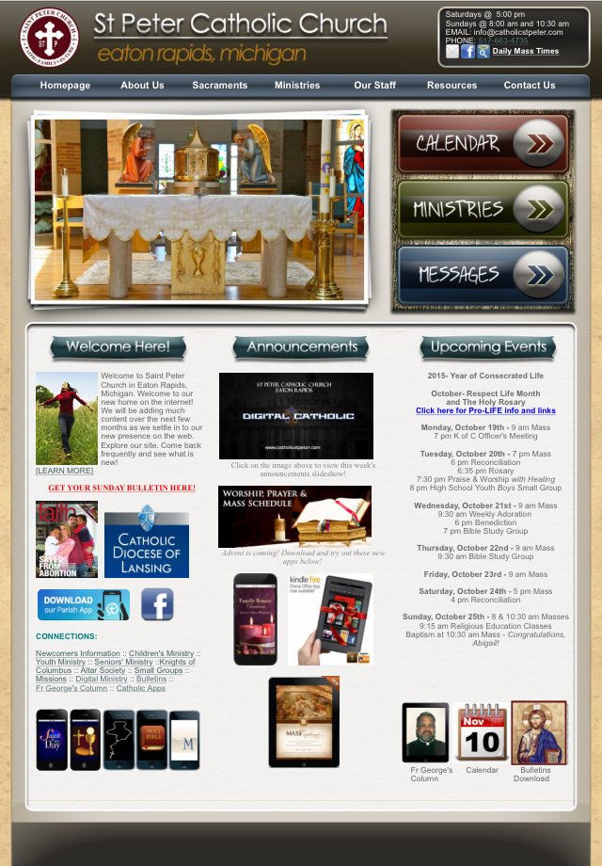
Our Parish Website www.catholicstpeter.com
Events Calendar Online Bulletin downloads
Homily recordings*, Pastor’s Blog*,
Evangelizing Videos*, Faith Sharing Stories*
Daily Readings Stations of the Cross
Ministry Information Online Rosary Prayers
Resources to help people LIVE CATHOLIC LIVES
Links to online education sites
Catholic apps for iPad, iPod, iPhone, Android*, Kindle*
Links to Catholic shopping, education sites and catholic magazines
Online Prayers, online books

Slide 9
Digital app sharing

Slide 10
Facebook
www.facebook.com/catholicstpeter
Events- people can be invited and click on the RSVP buttons
Post Evangelizing Videos on Facebook from our YouTube Channel*
Photo albums that encourage engaging. (Everyone can add their own photos taken at that event too!)
Post links to other Catholic sites and resources offering education on the Saint of the Day, Readings of the Day, Catholic Music, and so on.
Communicate deaths, births, marriages, celebrations of life, reception of the Sacraments, etc. celebrate life events as a community.

Slide 11
YouTube*
Our Own Video Channel!
Evangelization Videos
Homilies
Saint Stories
Skits and Plays
Presentations
Sharing Our Stories

Slide 12
Twitter*
Tweet our Facebook updates!
Create contests
Tweet our Facebook updates

Slide 13
Google +*
Anything we can do on Facebook
Searched by the Google Search Engines
Helps to be found by people who are not attending Mass

Slide 14
Digital Kiosk
Slide Announcements
Baptism Announcements
Life Events Announcements
Use in Presentations
Use for Praise and Worship
Use for Funeral Slideshows
Increase Communication
Reveal the beauty of our Faith with Catholic images
Educate with Saint Slides and Feast Day slides

Slide 15
development / Responsibilities Implementing our goals
YouTube Channel
Homily Recordings
Pastor’s Podcast
Pastor’s Blog
Calendar and Events List
Twitter
Facebook
Google+
Linked In
Pinterest
Digital Kiosk
Set Up Online Giving
Website Content Development
Catholic Apps and Sites to share
YouTube Video Creation
Educating the Ministry Leaders
Development of Ministry Pages
Creation of mobile version of website

